Slide 1

Social Distancing Detection for Covid-19 using Deep Learning
IT813 Computer Vision - End Sem Evaluation
[Feb-May 2021]
Submitted by:
Divyanshi Bhojak(202IT007) Tarushi Jat(202IT029)
Under the Supervision of:
Mr. Dinesh Naik

Slide 2
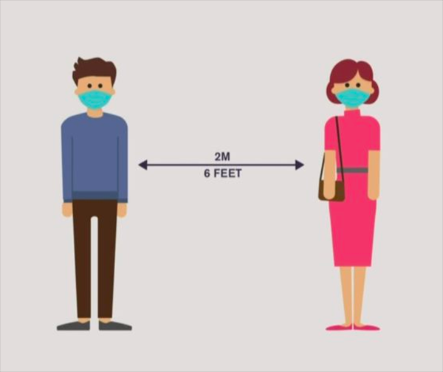
Introduction
Social Distancing, the term that has taken the world by storm and is transforming the way we live today.
In the fight against the COVID-19, social distancing has proven to be a very effective measure to slow down the spread of the disease.
Our project presents a methodology for social distancing detection using deep learning to mitigate the impact of this coronavirus pandemic.
The video frame from the camera was used as input, and the object detection pre-trained model YOLOv4 algorithm was employed for pedestrian detection.

Slide 3
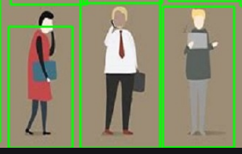
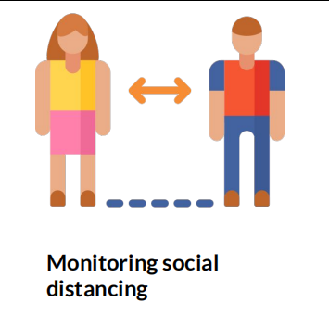
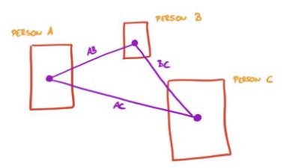

Our Project Goals
Object Detection
Monitoring Social Distancing
Distance Estimation between Pedestrians
Violation Email Alert

Slide 4

Dataset Used for the Task
Dataset taken is COCO- Common objects in context and is designed to represent a vast array of objects that we regularly encounter in everyday life.
COCO is a large-scale object detection, segmentation, and captioning dataset.
COCO Dataset Facts:
- The COCO Dataset has 121,408 images
- The COCO Dataset has 883,331 object annotations
- The COCO Dataset has 80 classes
- The COCO Dataset has median image ratio is 640 x 480

Slide 5
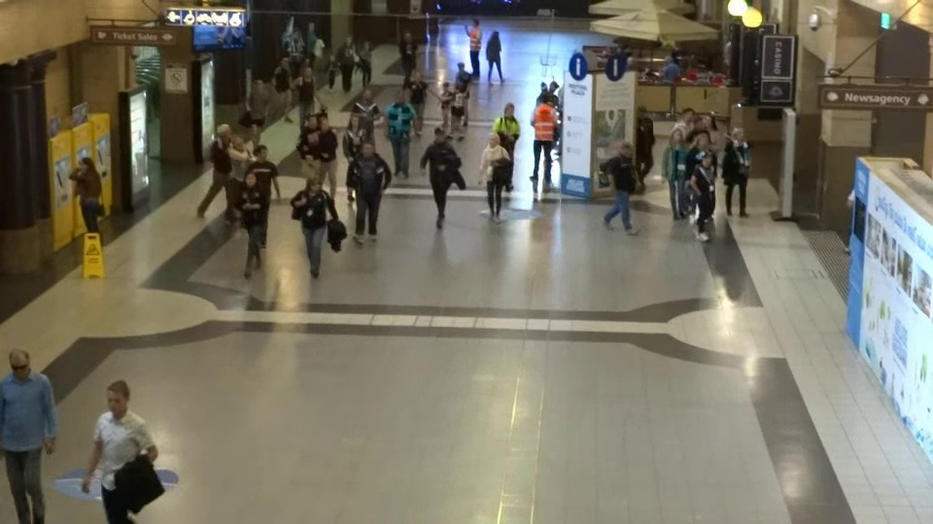
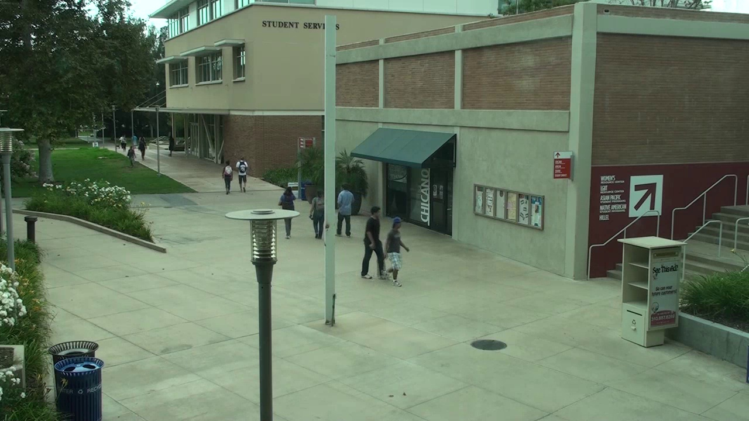
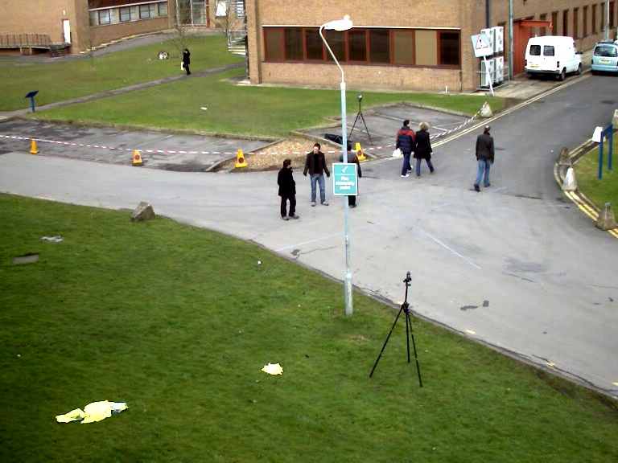
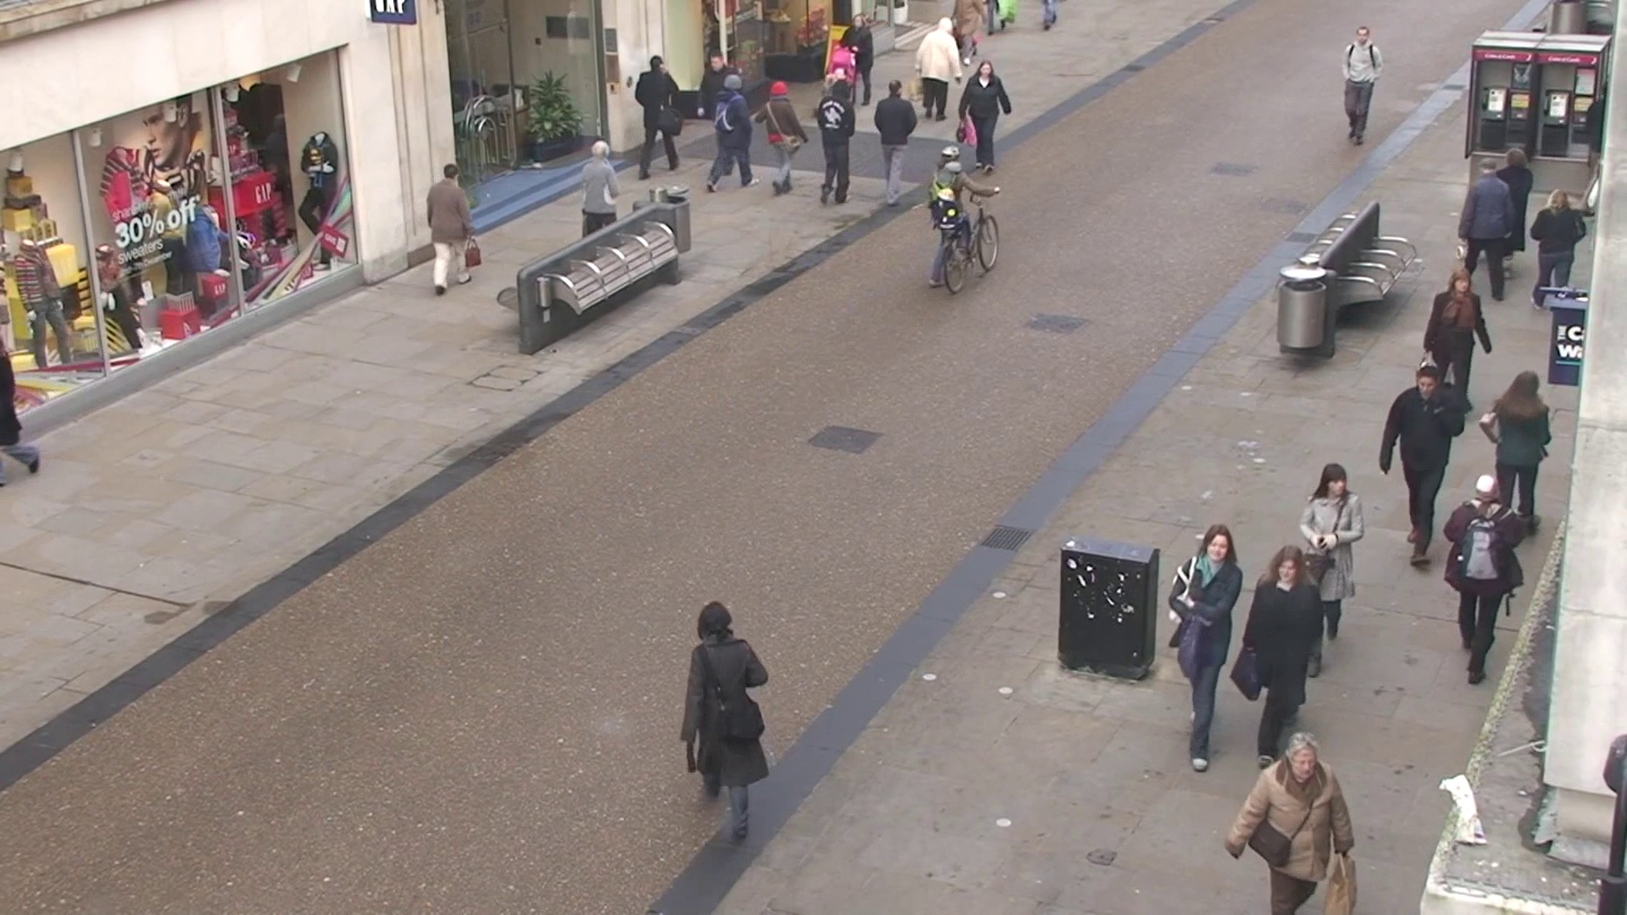
Input Videos Samples (Snapshots)
MOT20
StudentVideo
Pedestrian Walking
Town Centre

Slide 6
Methodology
The proposed methodology is to detect the safety distance between people in public spaces, an open-source object detection YOLOv3 & YOLOv4 algorithm was used to detect the pedestrian in the video frame.
From the detection result, only people class was used and then bounding box best fits for each detected pedestrian is drawn in the image, and these data of detected pedestrians will be used for the distance measurement between them.
The red bounding box represent the pedestrians whose distance with another pedestrian is below the acceptable threshold and the green bounding box represent the pedestrians who keep a safe distance from other pedestrians.
Consequently, we proposed an alert email mechanism sends alert message when distance between is below preset minimum acceptable distance.

Slide 7
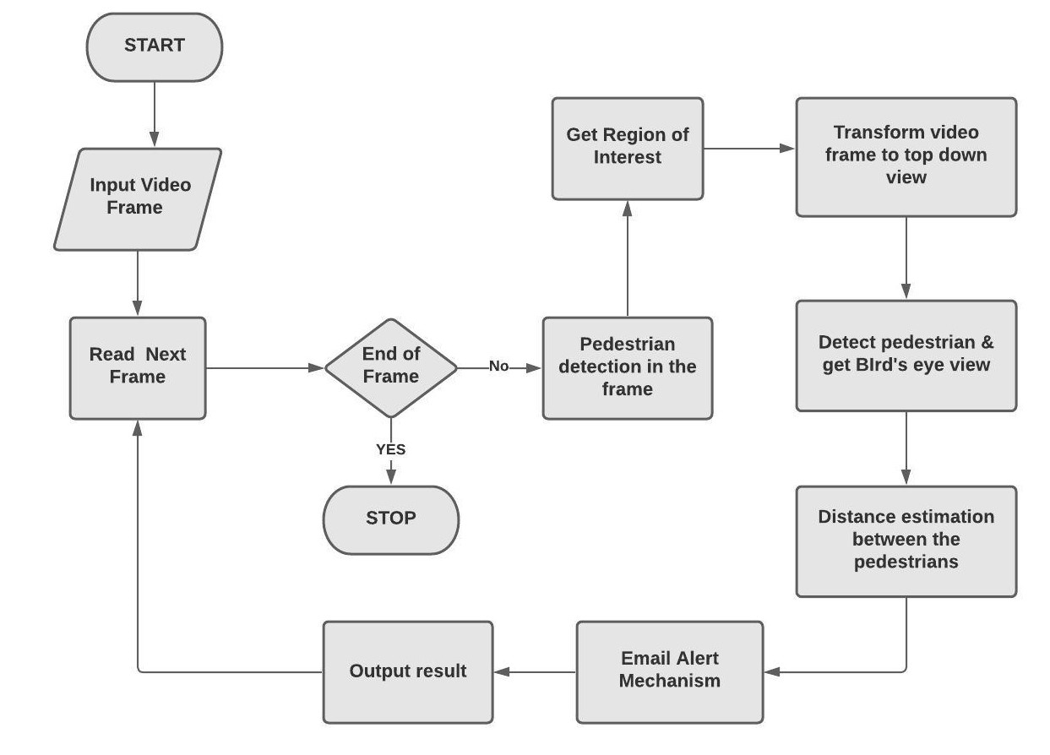
Proposed Workflow Architecture

Slide 8
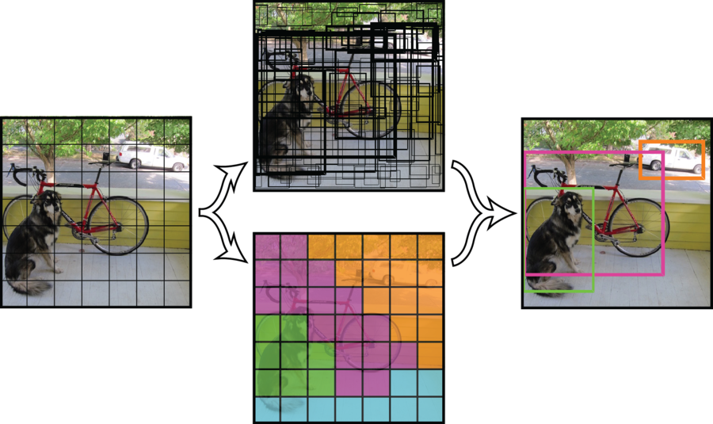
YOLO Object Detection Model
YOLO is short for You Only Look Once.
It is a real-time object recognition system that can recognize multiple objects in a single frame.
YOLO recognizes objects more precisely and faster than other recognition systems.
The real-time recognition system will recognize multiple objects from an image and also make a boundary box around the object.

Slide 9
YOLO Object Detection Model
We have used YOLOv3 and YOLOv4 pretrained models for social distancing detection between pedestrians.
Yolo version 3 has Darknet 53 as a backbone, on the other hand, yolo version 4 has CSPDarknet 53.
We adopted these YOLO models which are pre-trained on 117000 images containing objects belonging to 80 classes, including ‘human’.
Compared with YOLOv3, in the YOLO version 4, AP (accuracy) and FPS (frame rate per second) are improved by 10% and 12%,

Slide 10
Detailed Insight of our Project Work
Task-1: Detecting objects
Task-2: Detecting objects of only people class in input frame.
Task-3: Perform perspective transformation.
Task-4: Get bird’s eye view.
Task-5: Measure distance between detected pedestrian using euclidean distance.
Task-6: Surrounding them with red or green bounding boxes.
Task-7: Counting Number of people who are safe and who are in danger.
Task 8: Violation Alert Email mechanism.

Slide 11
People Class Detection
The next phase is people class detection and unique ID assignment for each individual.
From the inputted dataset and pre-recorded video our aim was to detect only pedestrians in the frame and other object classes are ignored in this application.
Consequently, after unique pedestrian detection in the frame bounding boxes will be created around each pedestrian
Hence, the bounding box best fits for each detected pedestrian can be drawn in the image, and this data of detected pedestrians will later used for distance estimation.

Slide 12
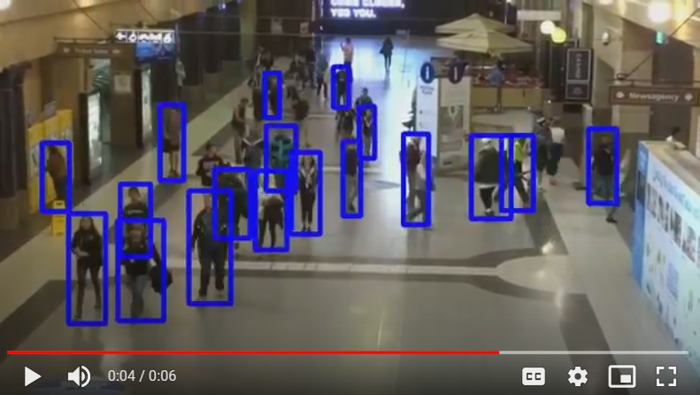
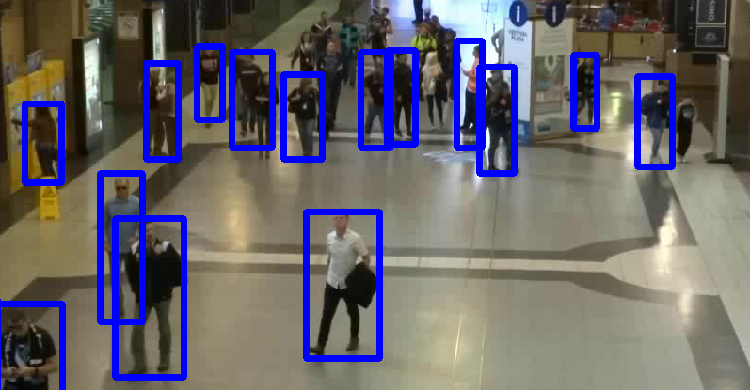
People Class Detection

Slide 13
Camera Perspective Transformation - Top View
Since our goal is to detect whether people are having enough distance between them or not, the first step is to transform perspective of input frame view to a top-down view.
In camera perspective transformation, we selected four coordinates as shown in the first image.
Then using warpPerspective library, we transform the frame into top view as shown in the second image.
Then further, in each frame every person will be assumed to be standing on the same flat plane and the distance will be measured.

Slide 14
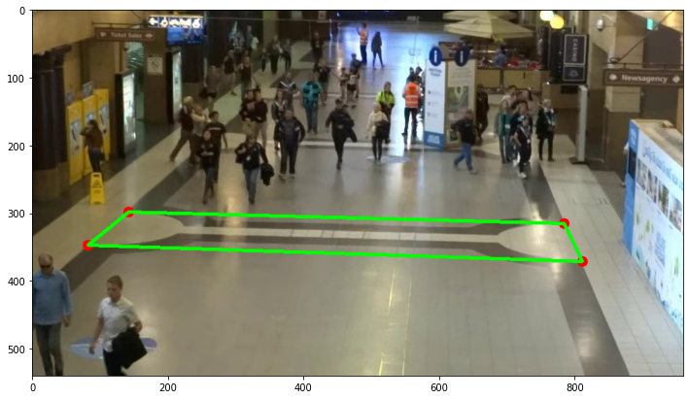
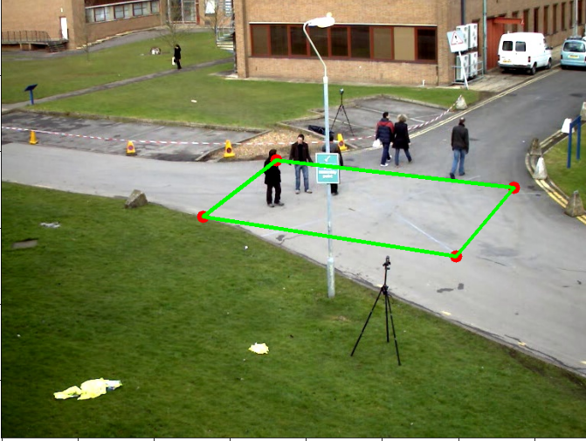
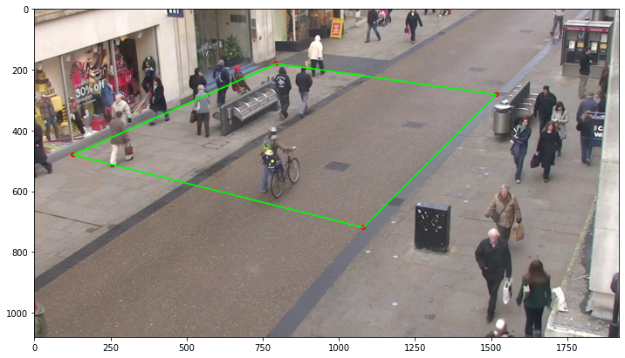
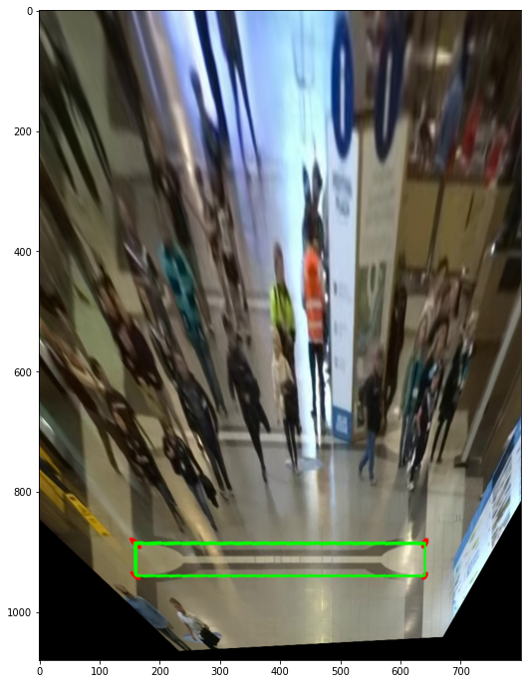
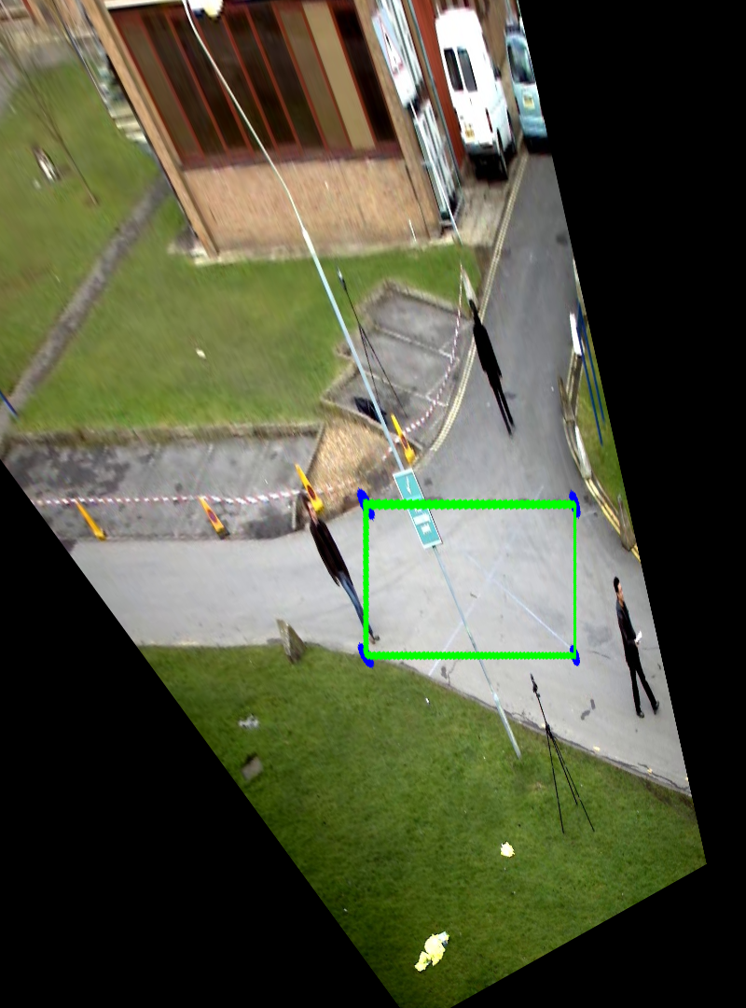
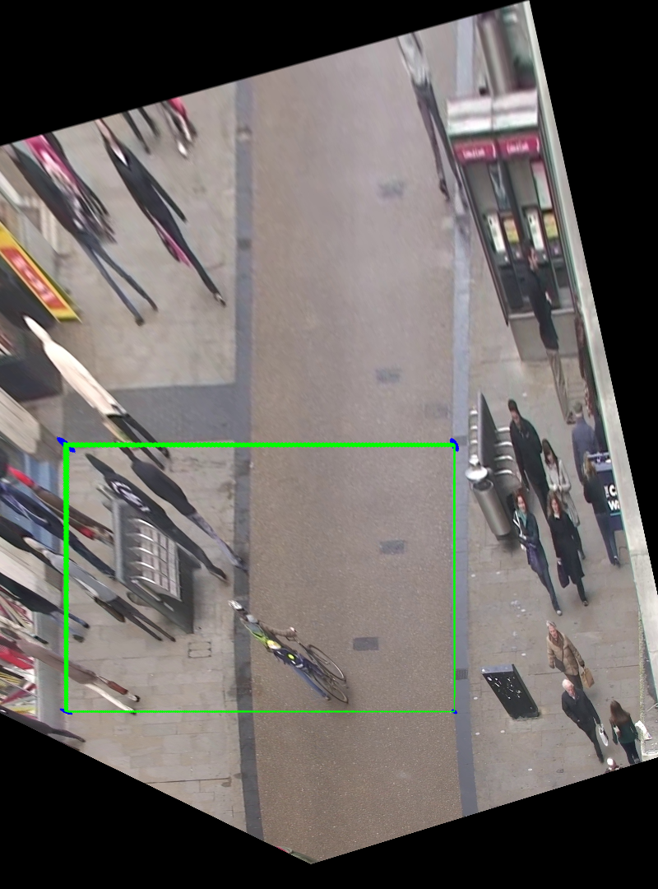
Camera Perspective Transformation - Top View

Slide 15
Bird’s Eye View
The perspective transformation is important to calculate the real world distances in the frame.
After this transformation, the position in the top-down view is estimated based on the bottom-center point of the bounding box for each pedestrian.
Then getting a bird's eye view by localizing pedestrian video from a top-down perspective in the region of interest.
This bird's eye view then has the property of points being equidistant no matter where they are. All it needs is a multiplier that maps the distance between two points in pixels to distance.

Slide 16
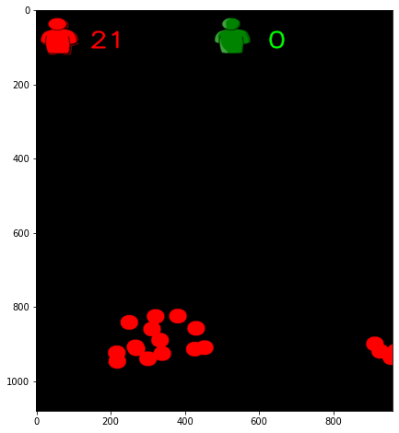
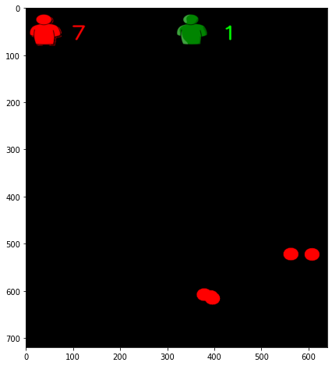
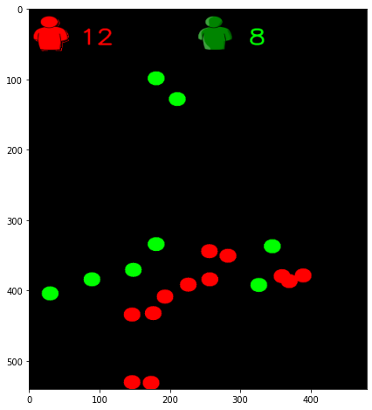
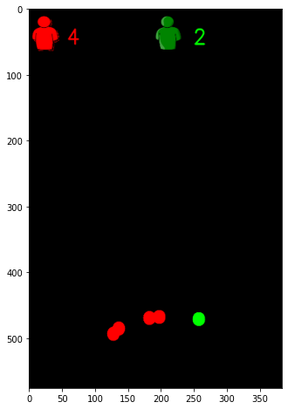
Bird’s Eye View of videos
Towncenter
StudentVideo
MOT20
PedestrianWalking

Slide 17
Bounding Box generation
After the distance estimation between the pedestrians, then we will generated colored bounding boxes.
red and green color bounding boxes will be generated based on the distance estimation.
Depending on the preset minimum precautionary distance if the distance between any two non complaint pairs of pedestrians is less than acceptable distance will be indicated with a red bounding box for those pedestrians that serve as precautionary warnings.
And when the maintain the safe and acceptable distance then bounding box will be depicted by green color.

Slide 18
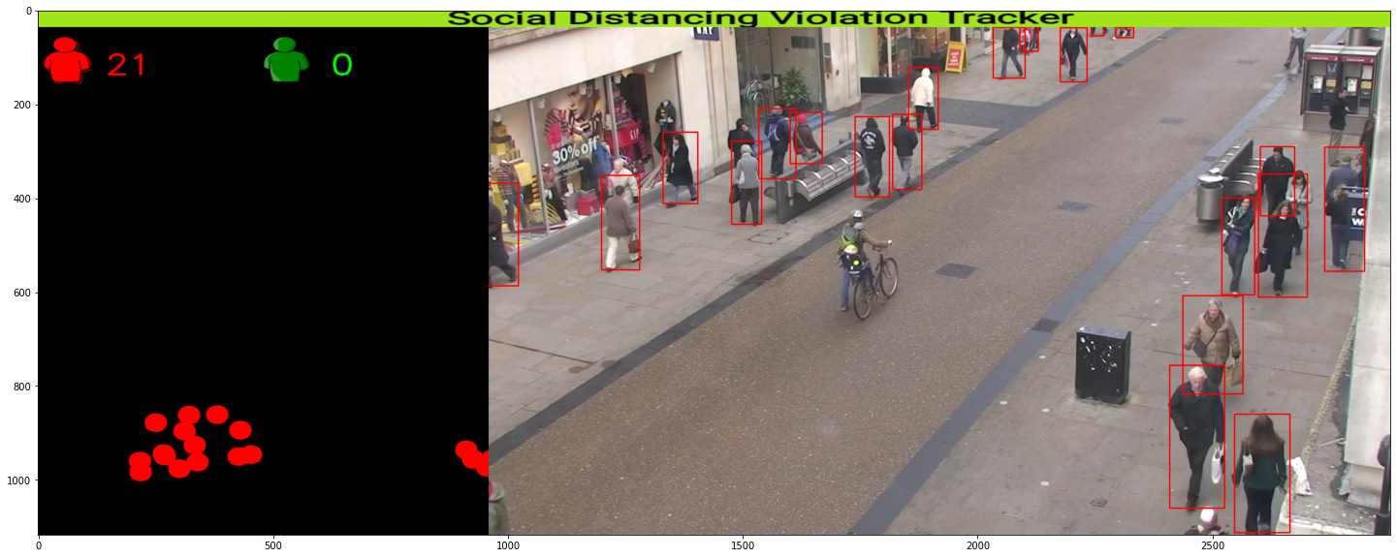
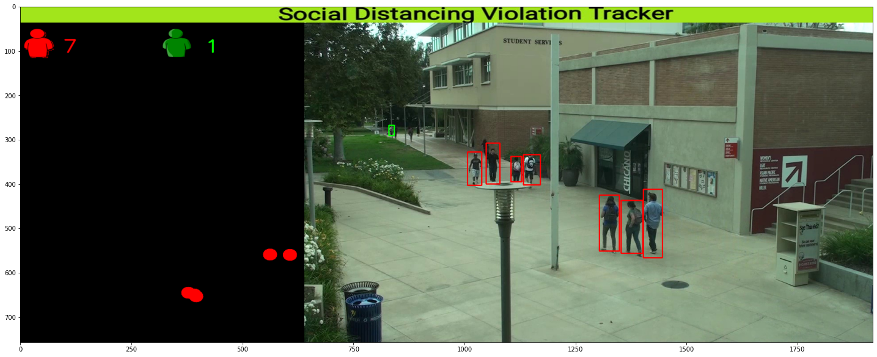
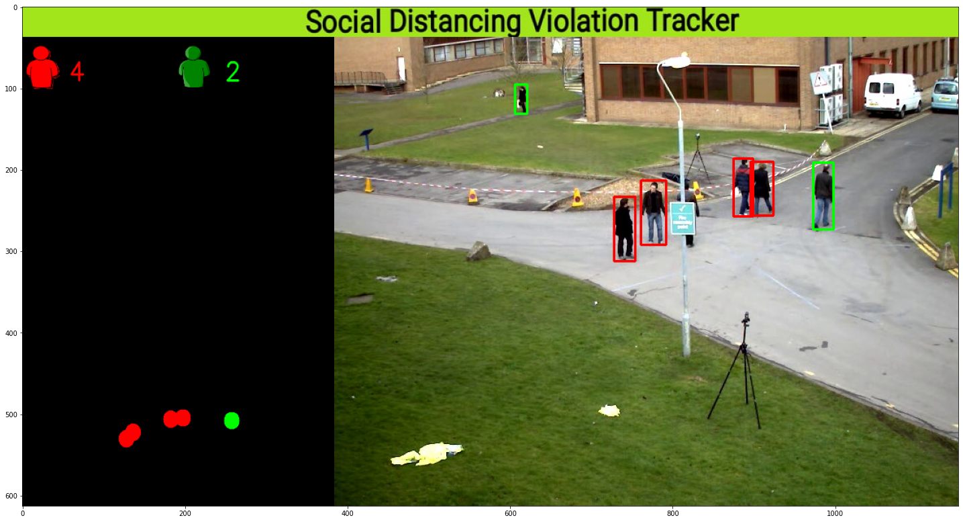
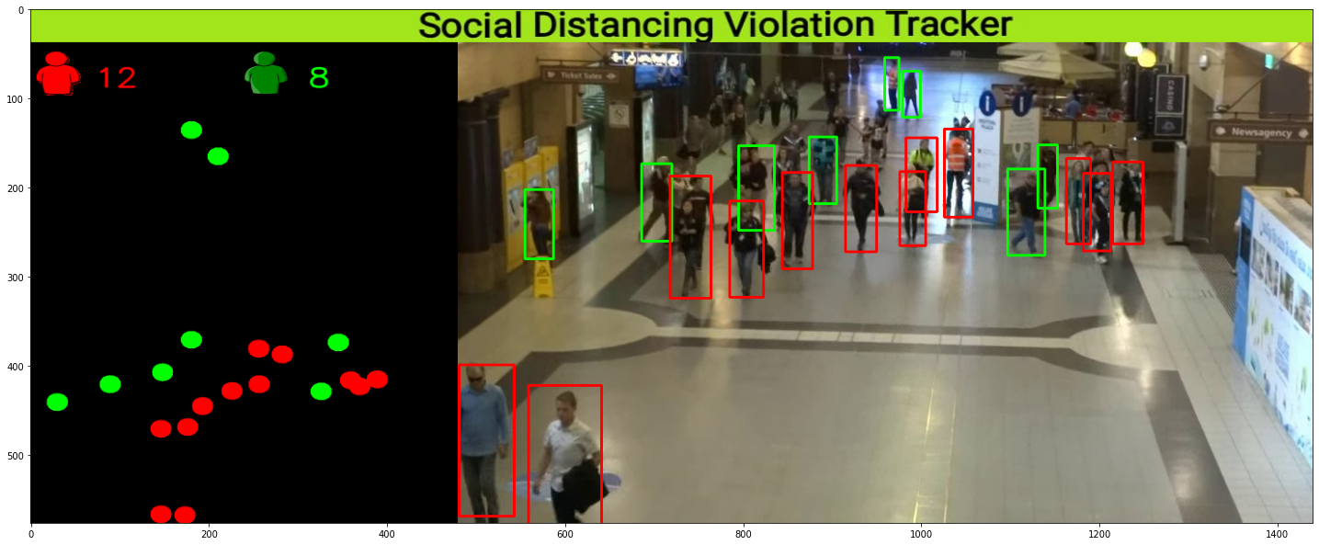
Towncenter
StudentVideo
PedestrianWalking
MOT20

Slide 19

Distance Estimation between Pedestrians
After the perspective transformation, the location for each pedestrian can be estimated to correspond to the number of pixels in earlier generated bird’s eye view.
Then distance is estimated between two non-complaint pairs of pedestrians using euclidean distance.
Given the position of two pedestrians in an image as (x1, y1) and (x2, y2) respectively, the d distance between the two pedestrians.

Slide 20
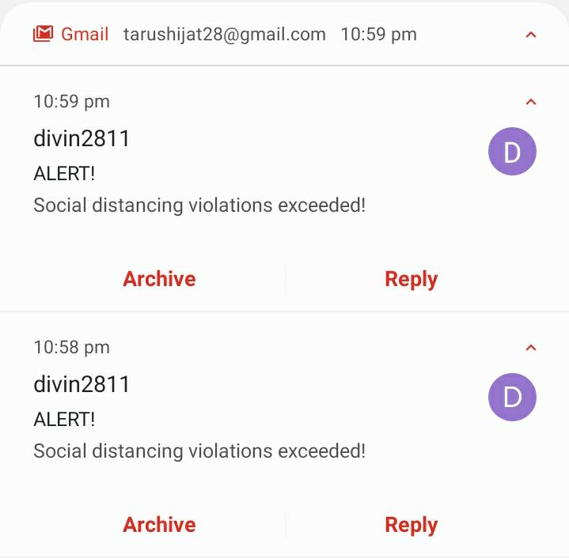
Email Alert Mechanism
After all the above phases, to create more awareness and to immediately prevent the violations made between the pedestrians.
So, if the distance between the pedestrians is below the acceptable distance and the bounding box color is red then we added a new mechanism to send an alert message through Email.
After detecting violation of social distancing in video frame alert message through Email will be sent stating the text message “Social Distancing Violations Exceeded! ”.

Slide 21
Experimental Results Analysis
Experimentation is performed on four input videos which show the pedestrians walking on streets, malls, outside a university and in a town.
The input videos are :
MOT20
TownCentre
PedestrianWalking
StudentVideo
Each Video is processed frame by frame and then the perspective view of the video frame is transformed into a top down view.
We calculated the distance between each of the detected pedestrians using Euclidean distance formula.

Slide 22
Experimental Results Analysis
A threshold value is being defined, to identify the number of pedestrians who are unsafe and not maintaining social distancing criteria.
To test the performance of the models used in this project for input videos with unknown ground truth, we have used the confidence score of detected boxes.
Confidence score of each of the detected objects in the video frames is being calculated.
To get the overall confidence score of each of the four input videos, the average of all confidence scores is being calculated.
Along with the detection of pedestrians violating the social distancing criteria with the help of red and green boxes, the total number of people who are safe and the total number of people who are unsafe is also calculated.

Slide 23
Experimental Results Analysis - Confidence Score
Video Name | YOLOv4 | YOLOv3
MOT20 | 0.8440056110991888 | 0.7503122930372382
Town Centre | 0.8816814148867955 | 0.7883997548728089
Pedestrian Walking | 0.9709215107691926 | 0.8729871214650065
Student Video | 0.8703143704892438 | 0.8085678247857485

Slide 24
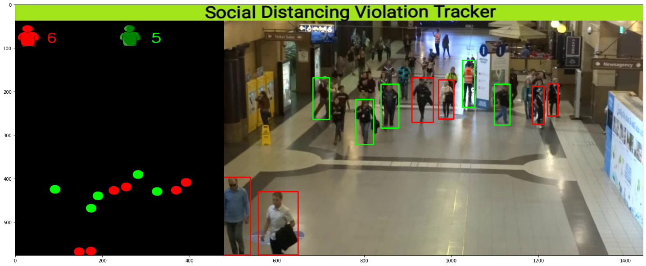
Experimental Results Analysis - Video Snapshots (MOT20)
YOLO V4
YOLO V3

Slide 25
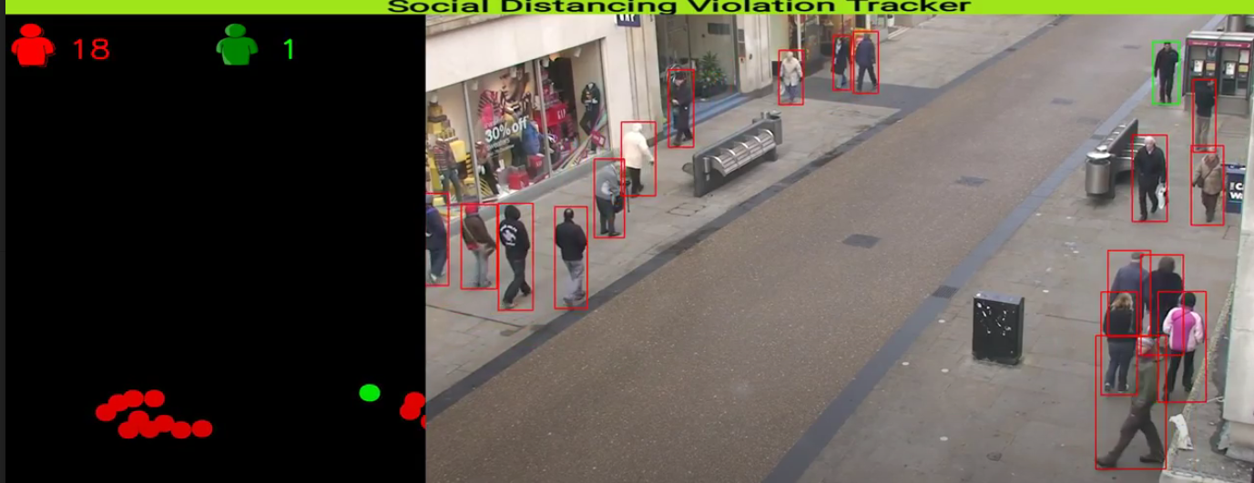
Experimental Results Analysis - Video Snapshots (Town Centre)
YOLO V4
YOLO V3

Slide 26
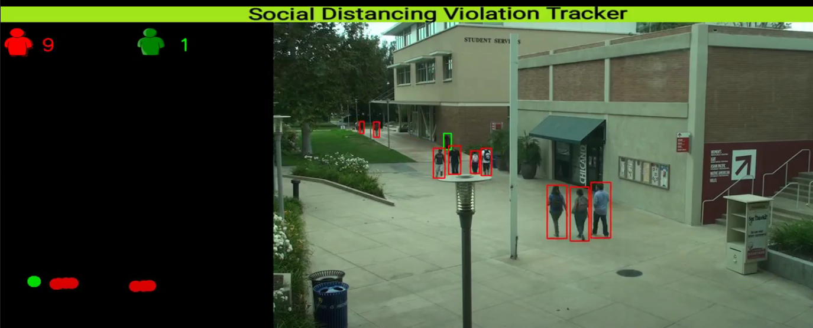
Experimental Results Analysis - Video Snapshots (Student Video)
YOLO V4
YOLO V3

Slide 27
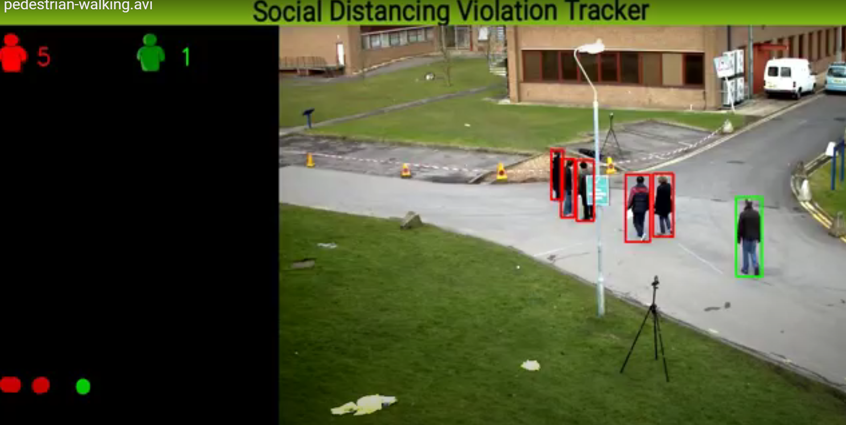
Experimental Results Analysis - Video Snapshots (Pedestrian Walking)
YOLO V4
YOLO V3

Slide 28
Conclusion & Future Work
In this project work, a methodology of social distancing detection for covid19 using deep learning model is proposed.
With the help of computer vision technology, the distance between people can be estimated and any pair of pedestrians violating the distance criteria are covered with the help of red boxes.
The proposed methodology is validated using four different input videos showing waking pedestrians.
The visualization results showed that the proposed method is capable of determining the social distance measure between people.
This model can be implemented in real life environments such as universities, public transport stations and many other places as a future work.

Slide 29
References
A deep learning-based social distance monitoring framework for COVID-19
https://www.sciencedirect.com/science/article/pii/S2210670720307897
Social Distancing Detection using Deep Learning Model. [Base Paper]
https://ieeexplore.ieee.org/stamp/stamp.jsp?arnumber=9243478
DeepSOCIAL: Social Distancing Monitoring and Infection Risk Assessment in COVID-19 Pandemic
https://www.mdpi.com/2076-3417/10/21/7514

Slide 30
Thank you!

